Slide 1
18-551 Project Proposal
Text Recognition and
Translation on the Go
Group 1
James Chun - jtchun@andrew.cmu.edu
Alex Baran - alex.v.baran@gmail.com
Tom Keagle - tkeagle@andrew.cmu.edu

Slide 2
Outline
Background
The Solution
  Background
  Novelty
Previous Projects
What We'll Do
Tasks
Demonstration
Hardware and Purchases
Schedule
Resources

Slide 3
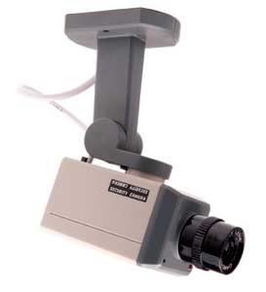
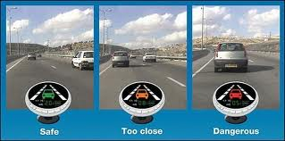
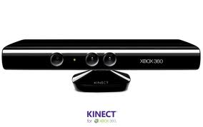
Background
Embedded Vision
  Embedded Systems that extract meaning from visual inputs
  Increasingly used in today’s mobile devices as well as in automotive safety, surveillance, and gaming
  Has potential for huge value

Slide 4
Background & Problem
Specific Problem: Mobile Devices
  Data input increasingly becomes the bottleneck
  Mobile Camera is the highest bandwidth input device readily available
  Image extraction and recognition is crucial
  Our application seeks to solve a subset of this – text recognition and translation

Slide 5
Specific Issue
International travelers need quick translation in foreign countries
While many famous sights have multi-lingual signs, many places of travel do not
Restricts the amount of culture you are able to absorb without paying for a guide or learning the language
Simple translation may be needed to perform basic navigation

Slide 6
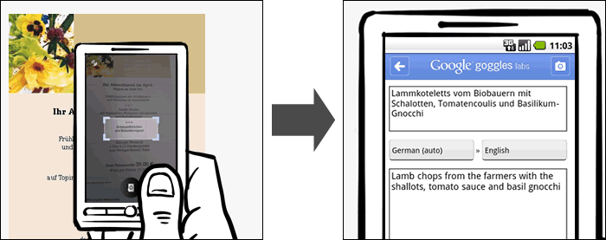
The Solution
Google goggles currently allows translation
from captured images
Inputs user defined cropped area as input
Depends on the quality of the picture
Can select the input and output language for translation

Slide 7
Novelty
Develop an application that will recognize text and translate it
Use the Google Translate API in a similar fashion to that of Google Goggles
Add versatility after basic inputs are mastered
Possible additions: deskew slanted images,multiple fonts and backgrounds, and live translation through video feed

Slide 8
Previously in 18-551
So far, no previous 18-551 group has tackled the same project we propose. However, there have been a few past projects that implemented systems similar to the ones we will need to complete pieces of our application.

Slide 9
Spring 2011 Group 6 – Album Digitalization
Worked with OCR to convert album labels
We would focus more on the word conversion
Can use the experimental findings to anticipate some of the problems they faced
For example, “EX” being read as one letter

Slide 10
Fall 2007 Group 3 – Handwriting Recognition
Cursive handwriting segmentation and character recognition
Different segmentation for cursive input
Can use word segmentation process to seperate characters
Character recognition tool, Support Vector Machines
Used thresholding to convert input images to grayscale
Used normalization to eliminate slanting and skew
Improved efficiency through zero padding and thinning
Three other older groups had similar projects to this group

Slide 11
Spring 2003 Group 8 - License Plate Recognition
Reading and recognizing license plates
Used a character recognition system implemented Adaptive Binarization to enhance text and background contrast
Different character segmentation method than the handwriting group
Another group in 2000 had a similar project to this one but used Histogram Equalization

Slide 12
What We Will Do
Continue in-depth research of Google Goggles and other online OCR tools
Gain a better understanding of what can be used directly, what can be translated from one programming language to another, and what we will need to create
Plan to use the simplest input – a direct camera image of English words standardized, capital font, black text on a white background
Expect to find documentation on similar systems to construct the framework
The more we can implement the more versatility we can add to the application

Slide 13
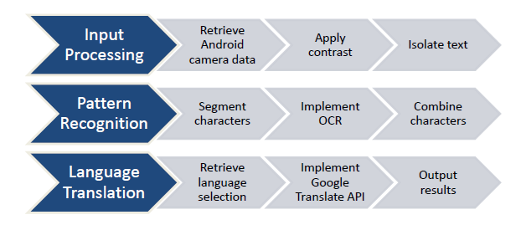
What We Will Do

Slide 14
Tasks: Basic Framework
Implement OCR for text recognition
  Capturing input and segmenting images
    Retrieve camera data from the tablet
    Isolate image text using thresholding and connected component analysis
    Apply segmentation and image scissoring to isolate character images
  Pattern recognition: character images to ASCII characters (and words)
    Implement OCR Engine and train program to get ASCII representations of the images
    Combine characters to form the original text words
    Confirm that the results match the input with a low error rate (<10%)
Implement translation: input language to output language
  Create menu for language selection
  Establish Google Translate API plugin
Confirm translation success with low error rate (<10%)

Slide 15
Tasks: Additions for Versatility
Add capability to recognize lowercase letters and multiple fonts
Implement a process to deskew camera input for indirect capturing angles
Train OCR to work regardless of text/background colors
Allow application to work for multiple input (and output) languages
Make language menu optional, implementing the Google Translate language detection
Allow application to run on a video feed
Continuous input without needing to capture an image
Dynamic output generated and posted live

Slide 16
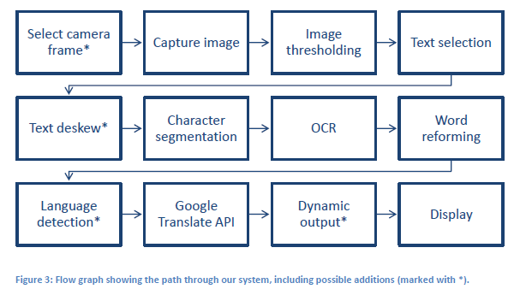
Tasks: Layout

Slide 17
Demonstration
The final demonstration should at least show that our application can translate a simple word from a camera image.
Depending on our progress, the demo will also display any and all additions we were able to implement to make the application more versatile.

Slide 18
Hardware and Purchases
Don't anticipate the need for additional hardware
We will evaluate camera resolution and would consider using a better camera to input images
Need to access Google Translate API for text translation
  Small amount of translations over the semester
  Usage Fee should not exceed $20
If we implement language detection, we would use a separate feature in the Google Translate API
  Similar constraints to the translation, under $20

Slide 19
Schedule of Tasks
We plan to all work on each part of the project, though each group member will focus mainly on one area of the basic framework to research (as referenced in the list of tasks):
Alex – Google Translate API / Google Goggles
James – Image Isolation & Segmentation
Tom – Pattern Recognition

Slide 20
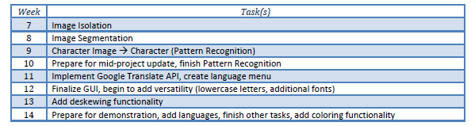
Weekly Schedule

Slide 21
References
Basic OCR Overview with code: http://blog.damiles.com/2008/11/basic-ocr-in-opencv/
Random OpenCV Instructions for Android phone: http://www.cs.bgu.ac.il/~tcv121/wiki.files/Instructions.pdf
iOS Computer Vision: http://aptogo.co.uk/2012/01/jump-into-our-new-tech-series-computer-vision/
Overview of Mobile CV: http://www.bdti.com/MyBDTI/pubs/201104_compvision.pdf
Automatic License Plate Recognition using Pythonand OpenCV Paper: http://sajjad.in/content/ALPR_paper.pdf

